Slide 1

The Egyptian E-Learning University (EELU)
Faculty of Computer & Information Technology
EELU- Assiut 2025
Graduation Project
Smart Health Checker
Project Supervisors
Dr. Ahmed Ezz
Dr. Yasmine Mahmoud
Eng. Eman Rizk Zaki

Slide 2
Project Members
Fady Romany Bekhet 2100129
Ebram Mechail Fahmy 2100210
Abdallah Ali Abdel Hameed 2100258
Mahmoud Ashraf Gaber 2101282
Yassa Gamal zaki 2101692
Mohamed Gamal Abdelneem 2100213
Mohamed Mostafa Fouad 2101196

Slide 3
Table of Contents
1. Introduction
. Problem Statement
. Motivation
. Objectives
2. Related Work
3. Functional Requirements
4.Methodology and Approach
5.Tools
6. System Architecture
7. Project Design
8. System Overview
9. Challenges Faced
10.Conclution and Future Work

Slide 4
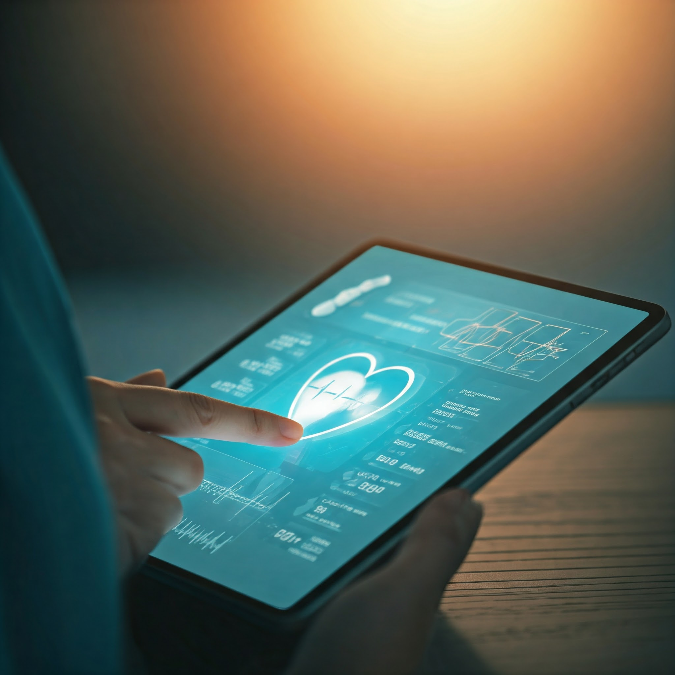
Introduction
01
A health monitoring system using ML to assist in diagnosing diseases.
Integrates lab test data and radiology image analysis for precise predictions
,generate a report for doctors to help
reducing check time .
Aims to make healthcare more accessible and efficient.

Slide 5

Important…
The Smart Health Checker is assist healthcare providers and patients in diagnosing diseases efficiently.
Targeted primarily at regions with limited healthcare access, such as conflict zones or during epidemics, this solution focuses on providing preliminary diagnostics, health guidance, and facilitating doctor-patient communication.

Slide 6
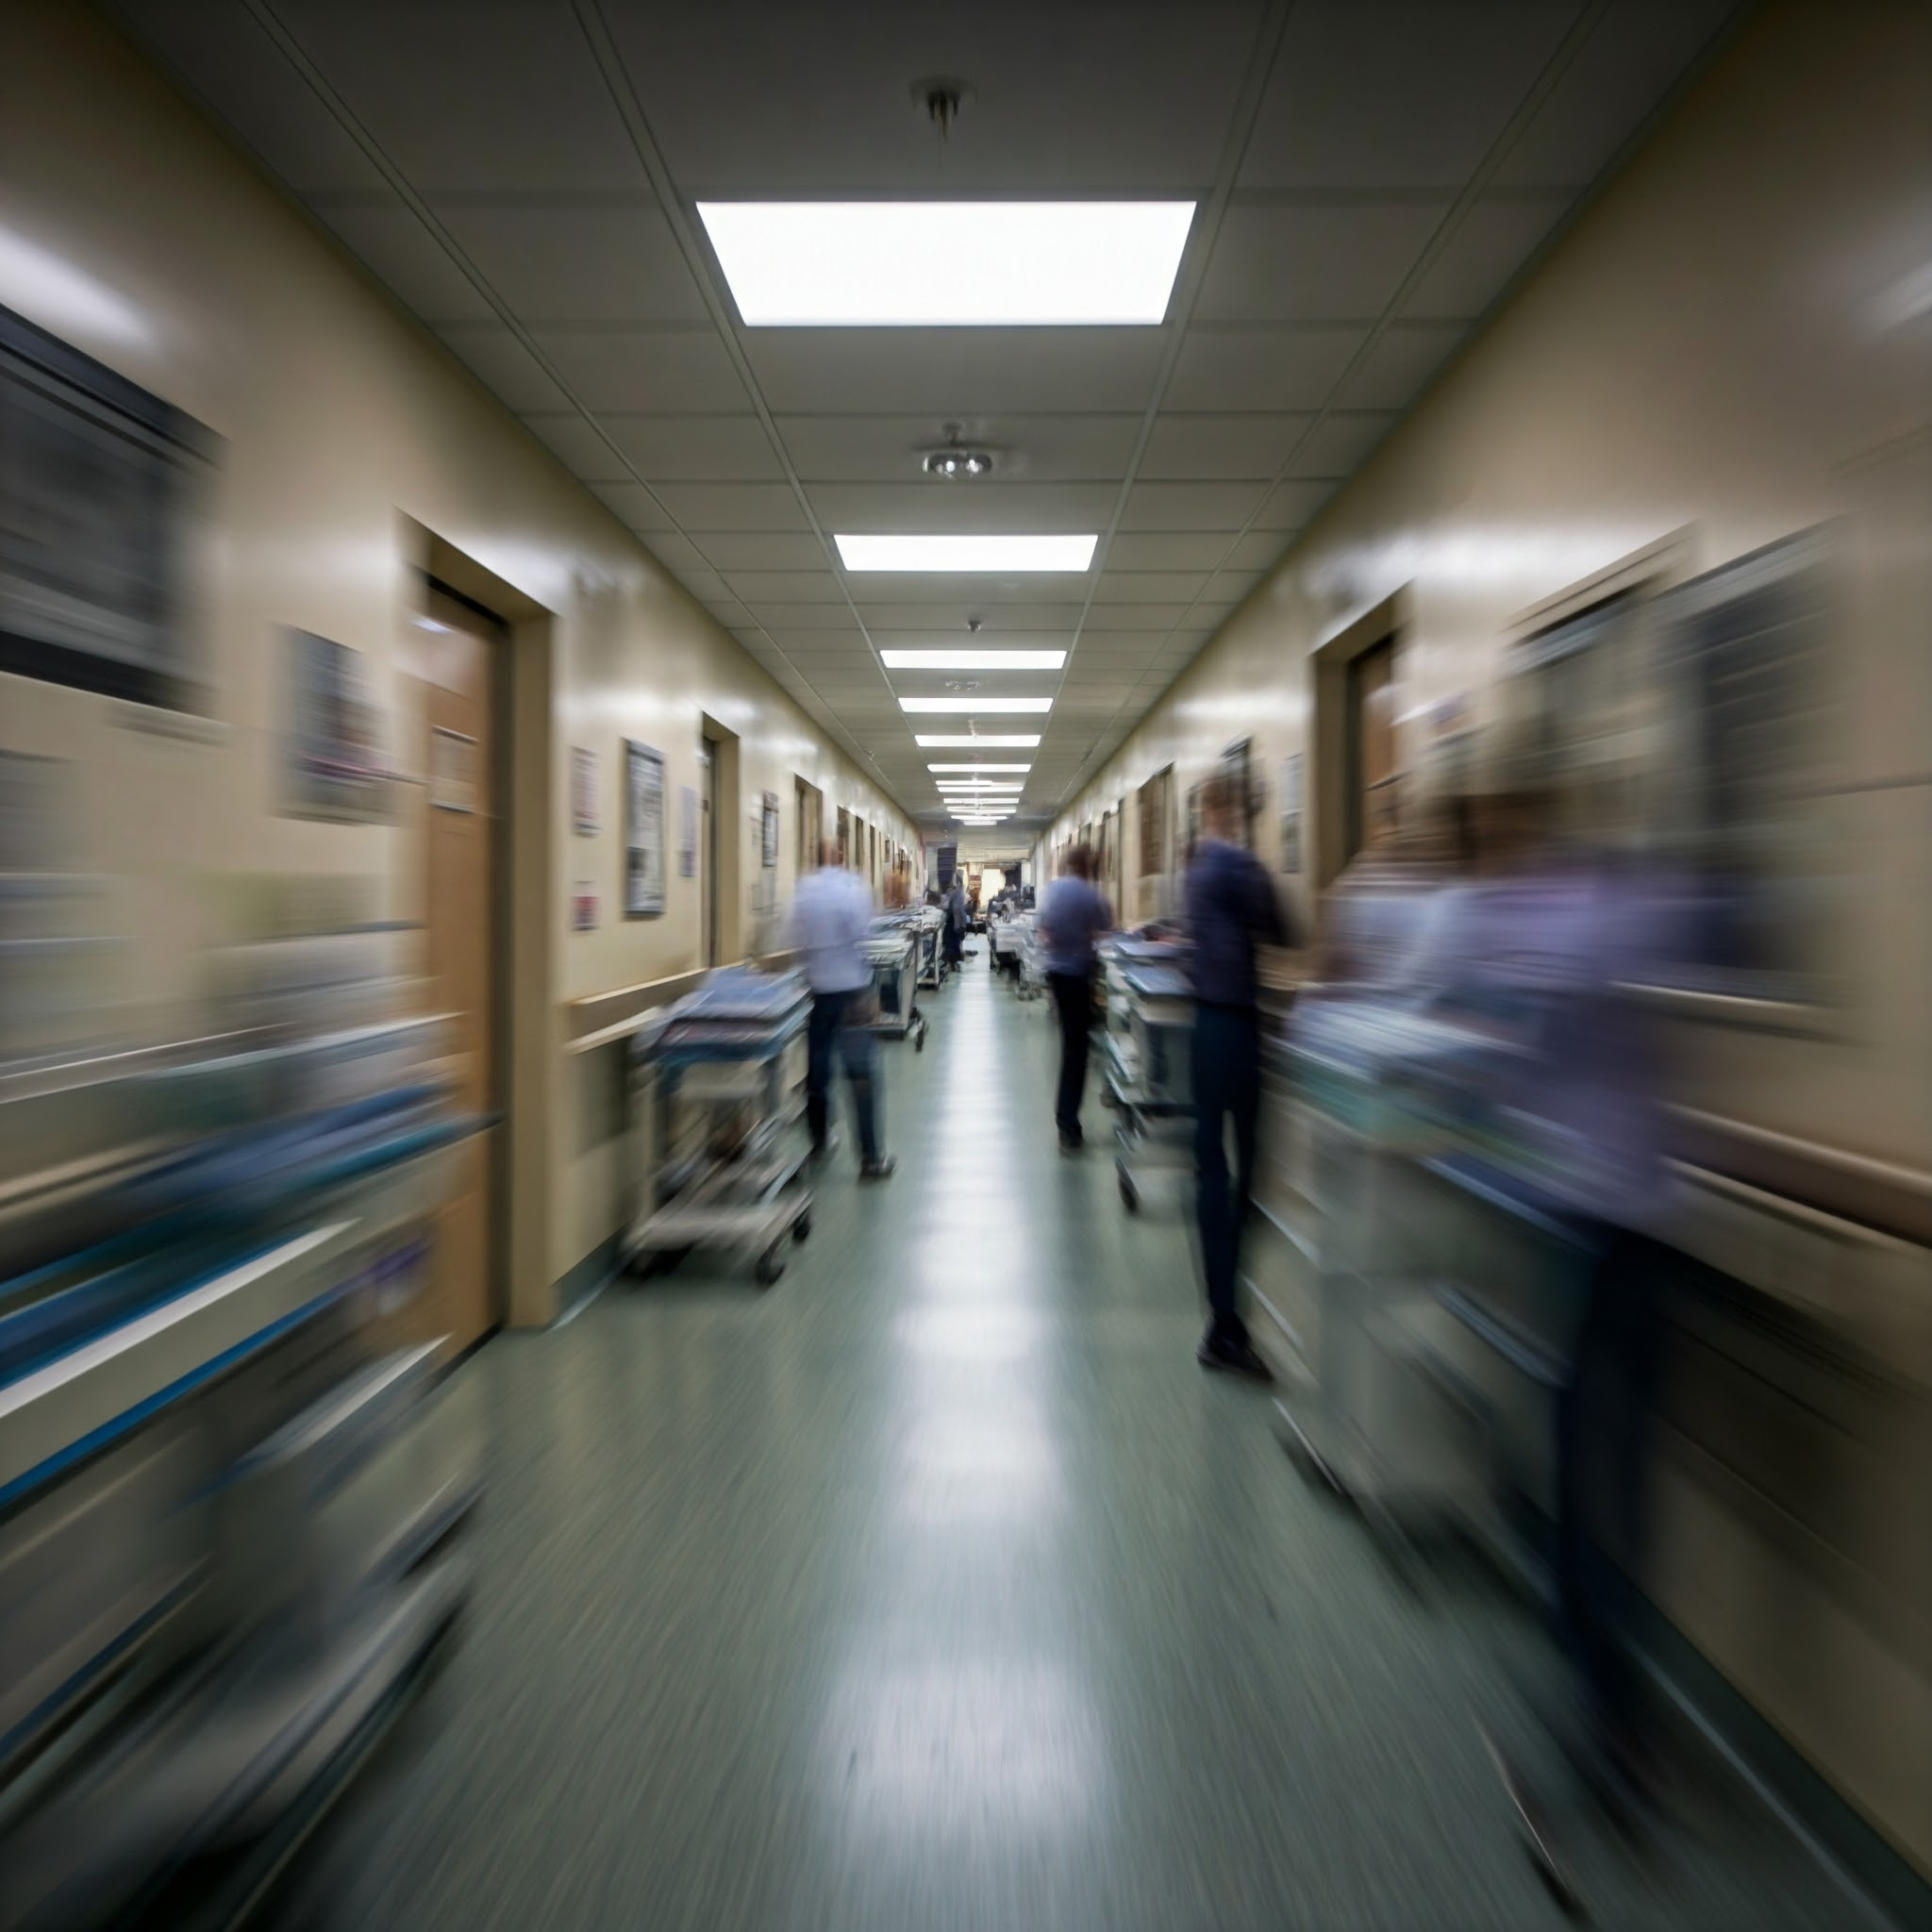
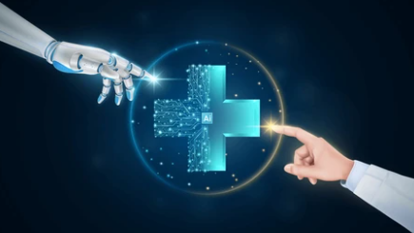
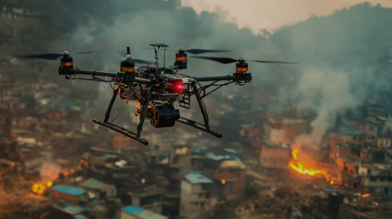
Problem Statement
Challenges in Remote and Conflict Zones:
A significant percentage of the global population lacks access to proper healthcare services, especially in areas affected by poverty, conflict, or natural disasters.
The shortage of qualified medical professionals worsens the situation, leaving many without timely diagnoses and treatments.
Overburdened Healthcare Systems:
Overcrowding during crises → delays + burnout.
Healthcare workers experience burnout, impacting the quality of service.
Need For Accessible Diagnostic Tools:
Current diagnostic methods often require specialized equipment and trained personnel.
Expensive/complex tools → need for affordable, user-friendly solutions.

Slide 7
Motivation
Bridging the Gap in Healthcare Delivery:
Millions of individuals in underserved regions lack basic diagnostic tools By leveraging technology, we can extend care to those who need it most.
Scalable Solutions Through ML:
Machine learning offers a cost-effective way to handle large volumes of health data, improving diagnostic accuracy and reducing reliance on physical resources.
Promoting Early Detection and Prevention:
Early intervention can save lives by identifying health conditions before they escalate. This app empowers users with actionable insights to manage their health proactively.

Slide 8
Objectives
Develop an Accessible Diagnostic Platform:
A user-friendly application for disease prediction and management, available on mobile and web platforms.
Deliver Health Insights and Recommendations:
Offer tailored health guidelines and preventive care suggestions based on test results.
Ensure Comprehensive Reporting:
Enable users to generate detailed, easy-to-read reports for personal tracking and medical consultations.
Provide Real-Time Interaction:
Seamless data processing and immediate feedback for users after tests or image uploads.

Slide 9
Related work
02
Azure Health Insights
Medical AI Assistant
High Cost
Limited Availability
Technical Complexity
Limited Compatibility

Slide 10
Functional Requirements
03
Our project is built with the following core functionalities:
Text / Imaging- Based Disease Diagnosis
Medical Reports

Slide 11



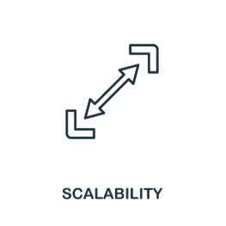
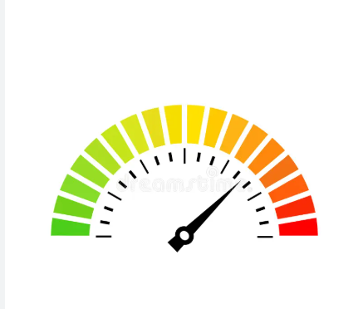
Non-Functional Requirements
5. Maintainability
1.
Security
4. Scalability
3.
Usability
2.
Performance

Slide 12
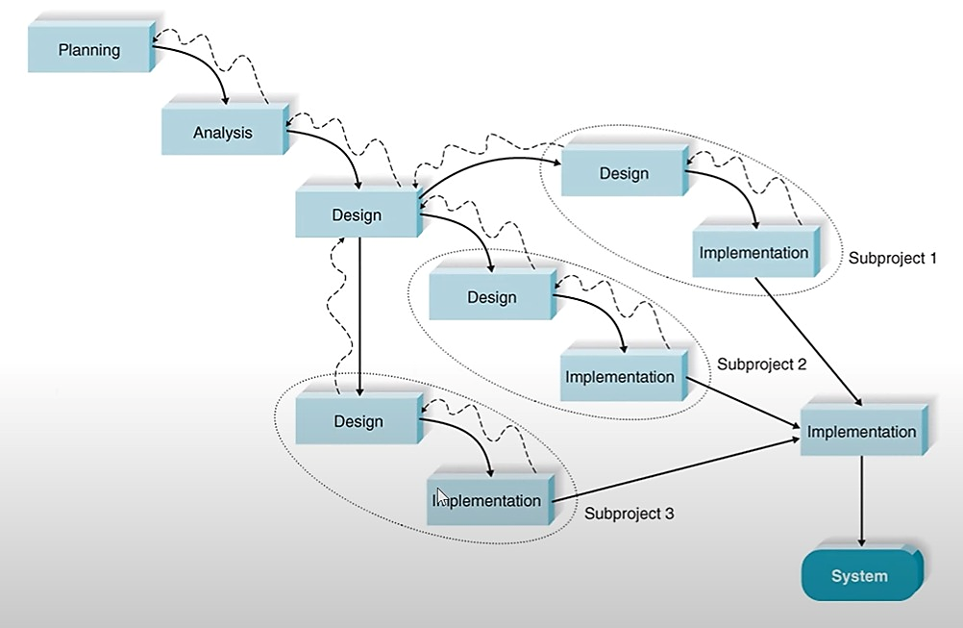
Methodologies and Approach
04
Phases of Parallel Methodology:
Planning.
Analysis.
Design.
Implementation.
Deployment
Testing.
Evaluation.

Slide 13





Tools
05
Frontend:
Flutter
Machin learning:
Sklearn
Pandas
Matplotlib
Tensorflow
Seaborn
keras
Backend:
PHP
Database:
MySQL

Slide 14
Tools (count…)
Our project is built with the following tools:
1. Disease Detection:
Using Machine learning models trained with Python libraries like:
scikit-learn: For model building.
pandas and numpy: For data manipulation.
seaborn and matplotlib: For visualizations.
2. Radiology Analysis:
Analyze radiology images for accurate diagnoses.
Powered by libraries like TensorFlow and OpenCV for image processing.

Slide 15
Tools (count…)
3. Frontend Development:
Mobile App: Developed using Flutter, including libraries for smooth UI/UX and cross-platform support.
4. Backend Development:
A FastAPI backend that processes user data and delivers real-time AI predictions through dynamically loaded disease-specific models.
5. Database:
Store user information, lab test data, and reports using MySQL .

Slide 16
System Architecture
06
The system architecture integrates multiple components for seamless functionality:
Frontend
Backend
Machine Learning Models
Database

Slide 17
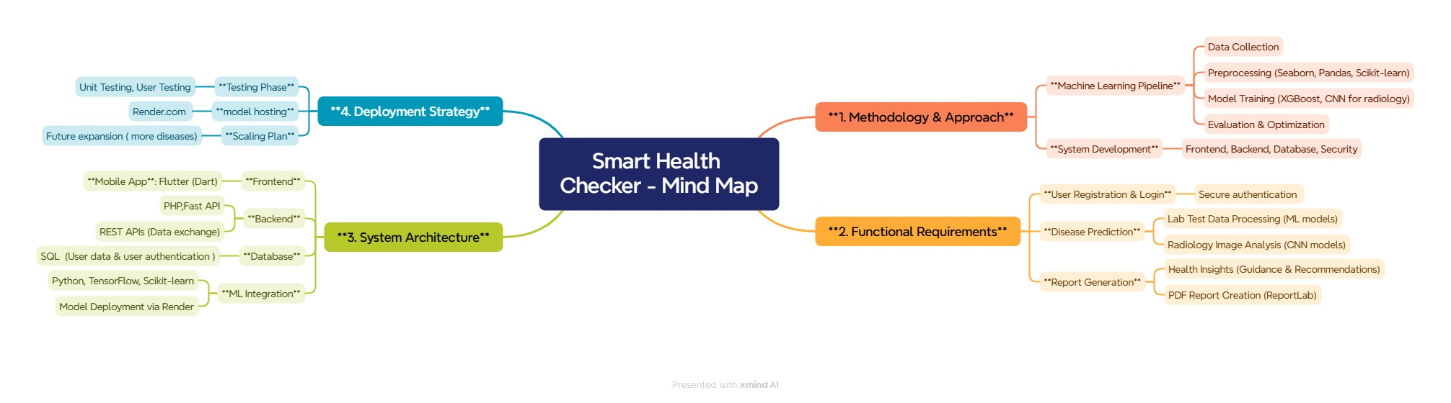
System Architecture (count…)
Mind Map:

Slide 18
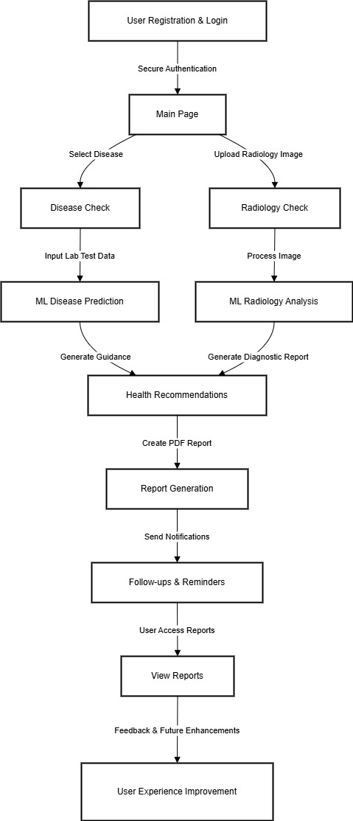
System Architecture (count…)
Flowchart:
Download pdf

Slide 19
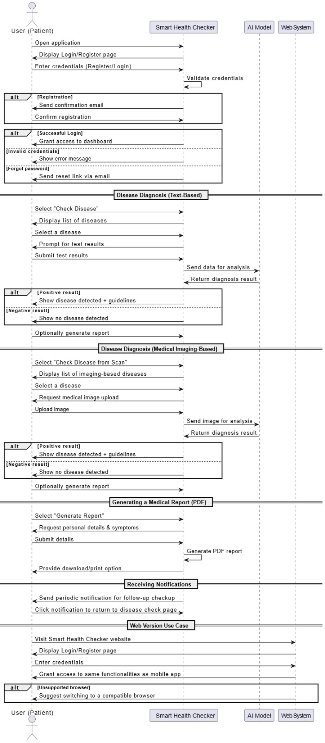
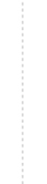
System Architecture (count…)
Sequence Diagram:

Slide 20
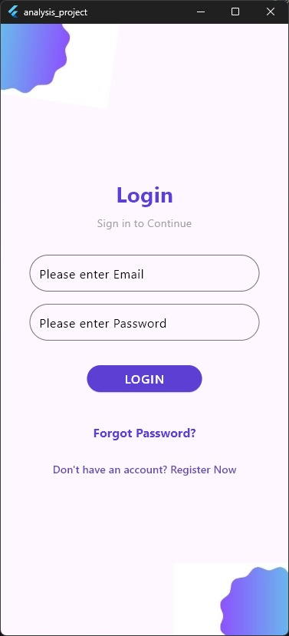
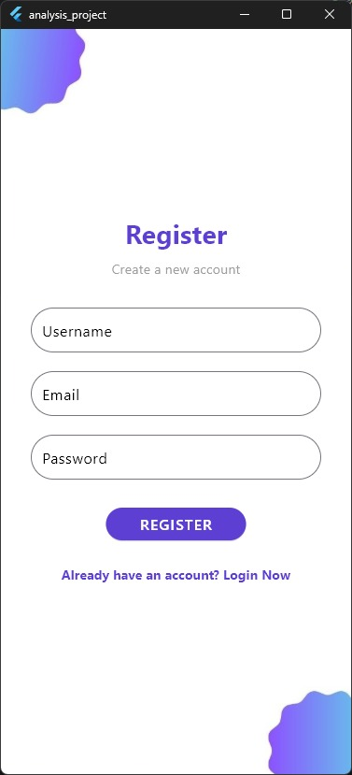
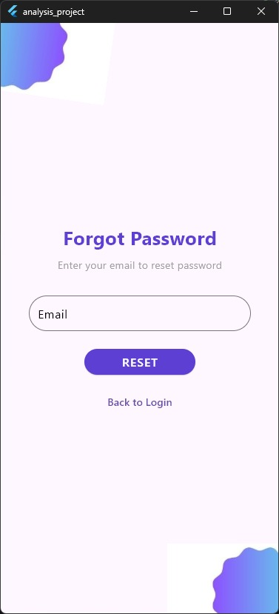
Project Design
07
1. User Interface
Login & Create Account: Secure authentication for users.

Slide 21
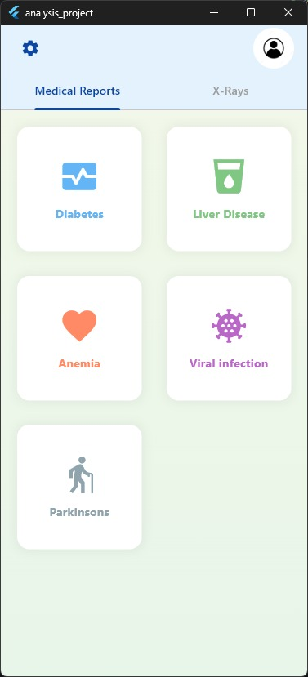
Project Design (count…)
Home Page: Central dashboard with options for:
X-ray Analysis: Users upload X-ray images
for disease detection.
Disease Check: Users input lab test data for
ML-based analysis.
Choose Disease: User can check any disease available in home page

Slide 22
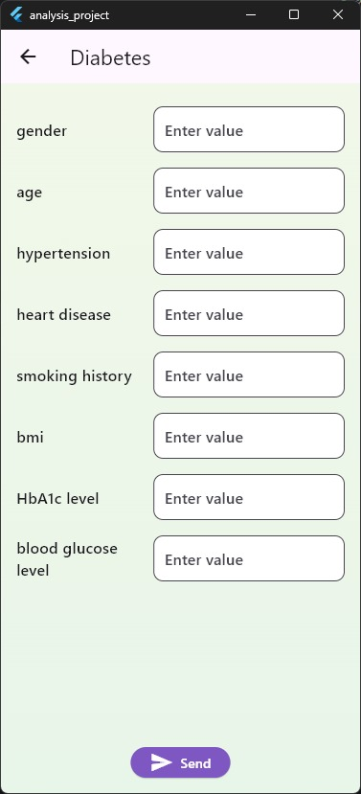
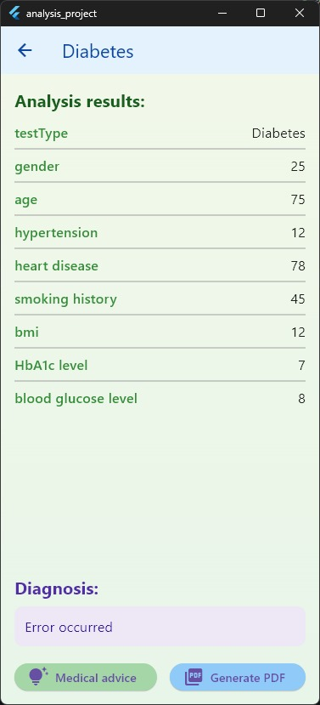
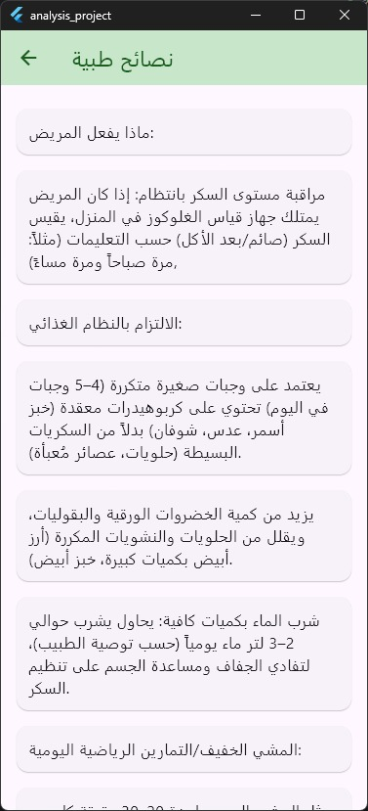
Project Design (count…)
Inputs clinical values
(HbA1c: 7, Blood Glucose: 8, BMI: 12)
Get results, get medical advice
and make Generate PDF
medical advice

Slide 23
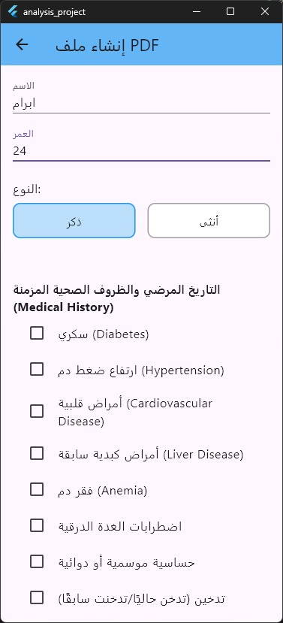
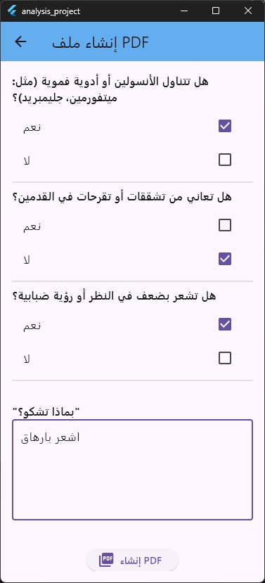
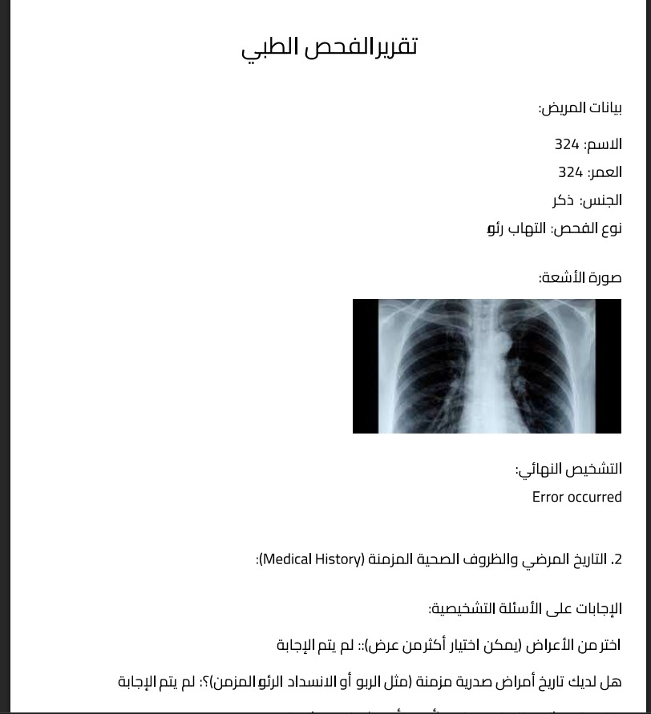
Project Design (count…)
Generate and get PDF

Slide 24
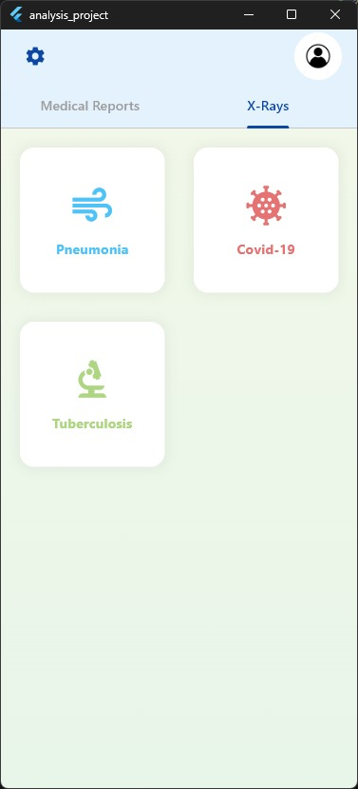
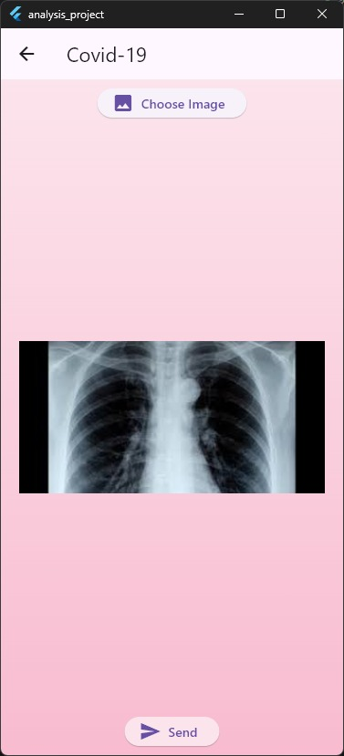
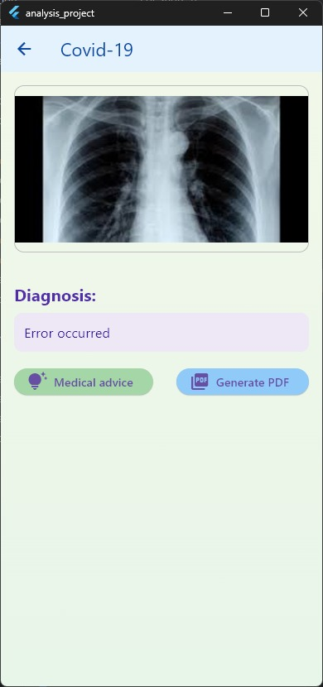
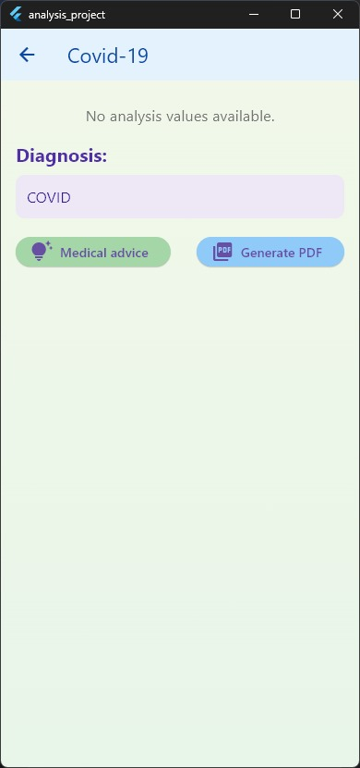
Project Design (count…)
X-ray disease process

Slide 25
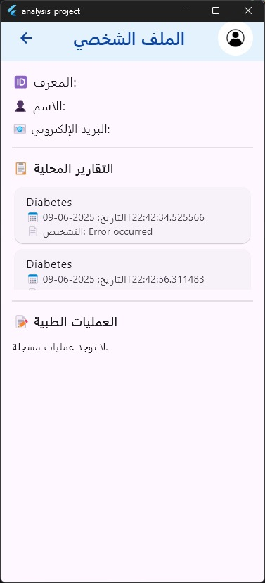
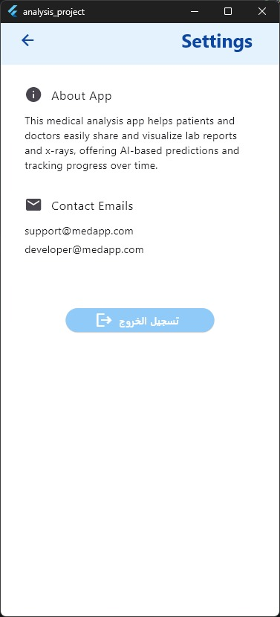
Project Design (count…)
Profile Management:
Users view their profile (ID, name, email)
About APP:
The application is designed to provide patients with an early disease-detection service, assist physicians, and reduce diagnostic time by generating a concise that supports medical staff.
Historical local Reports:
Access past medical reports
Support Channels:
Contact Emails
Medical Procedures:
Account Management:
Secure logout option to terminate sessions

Slide 26
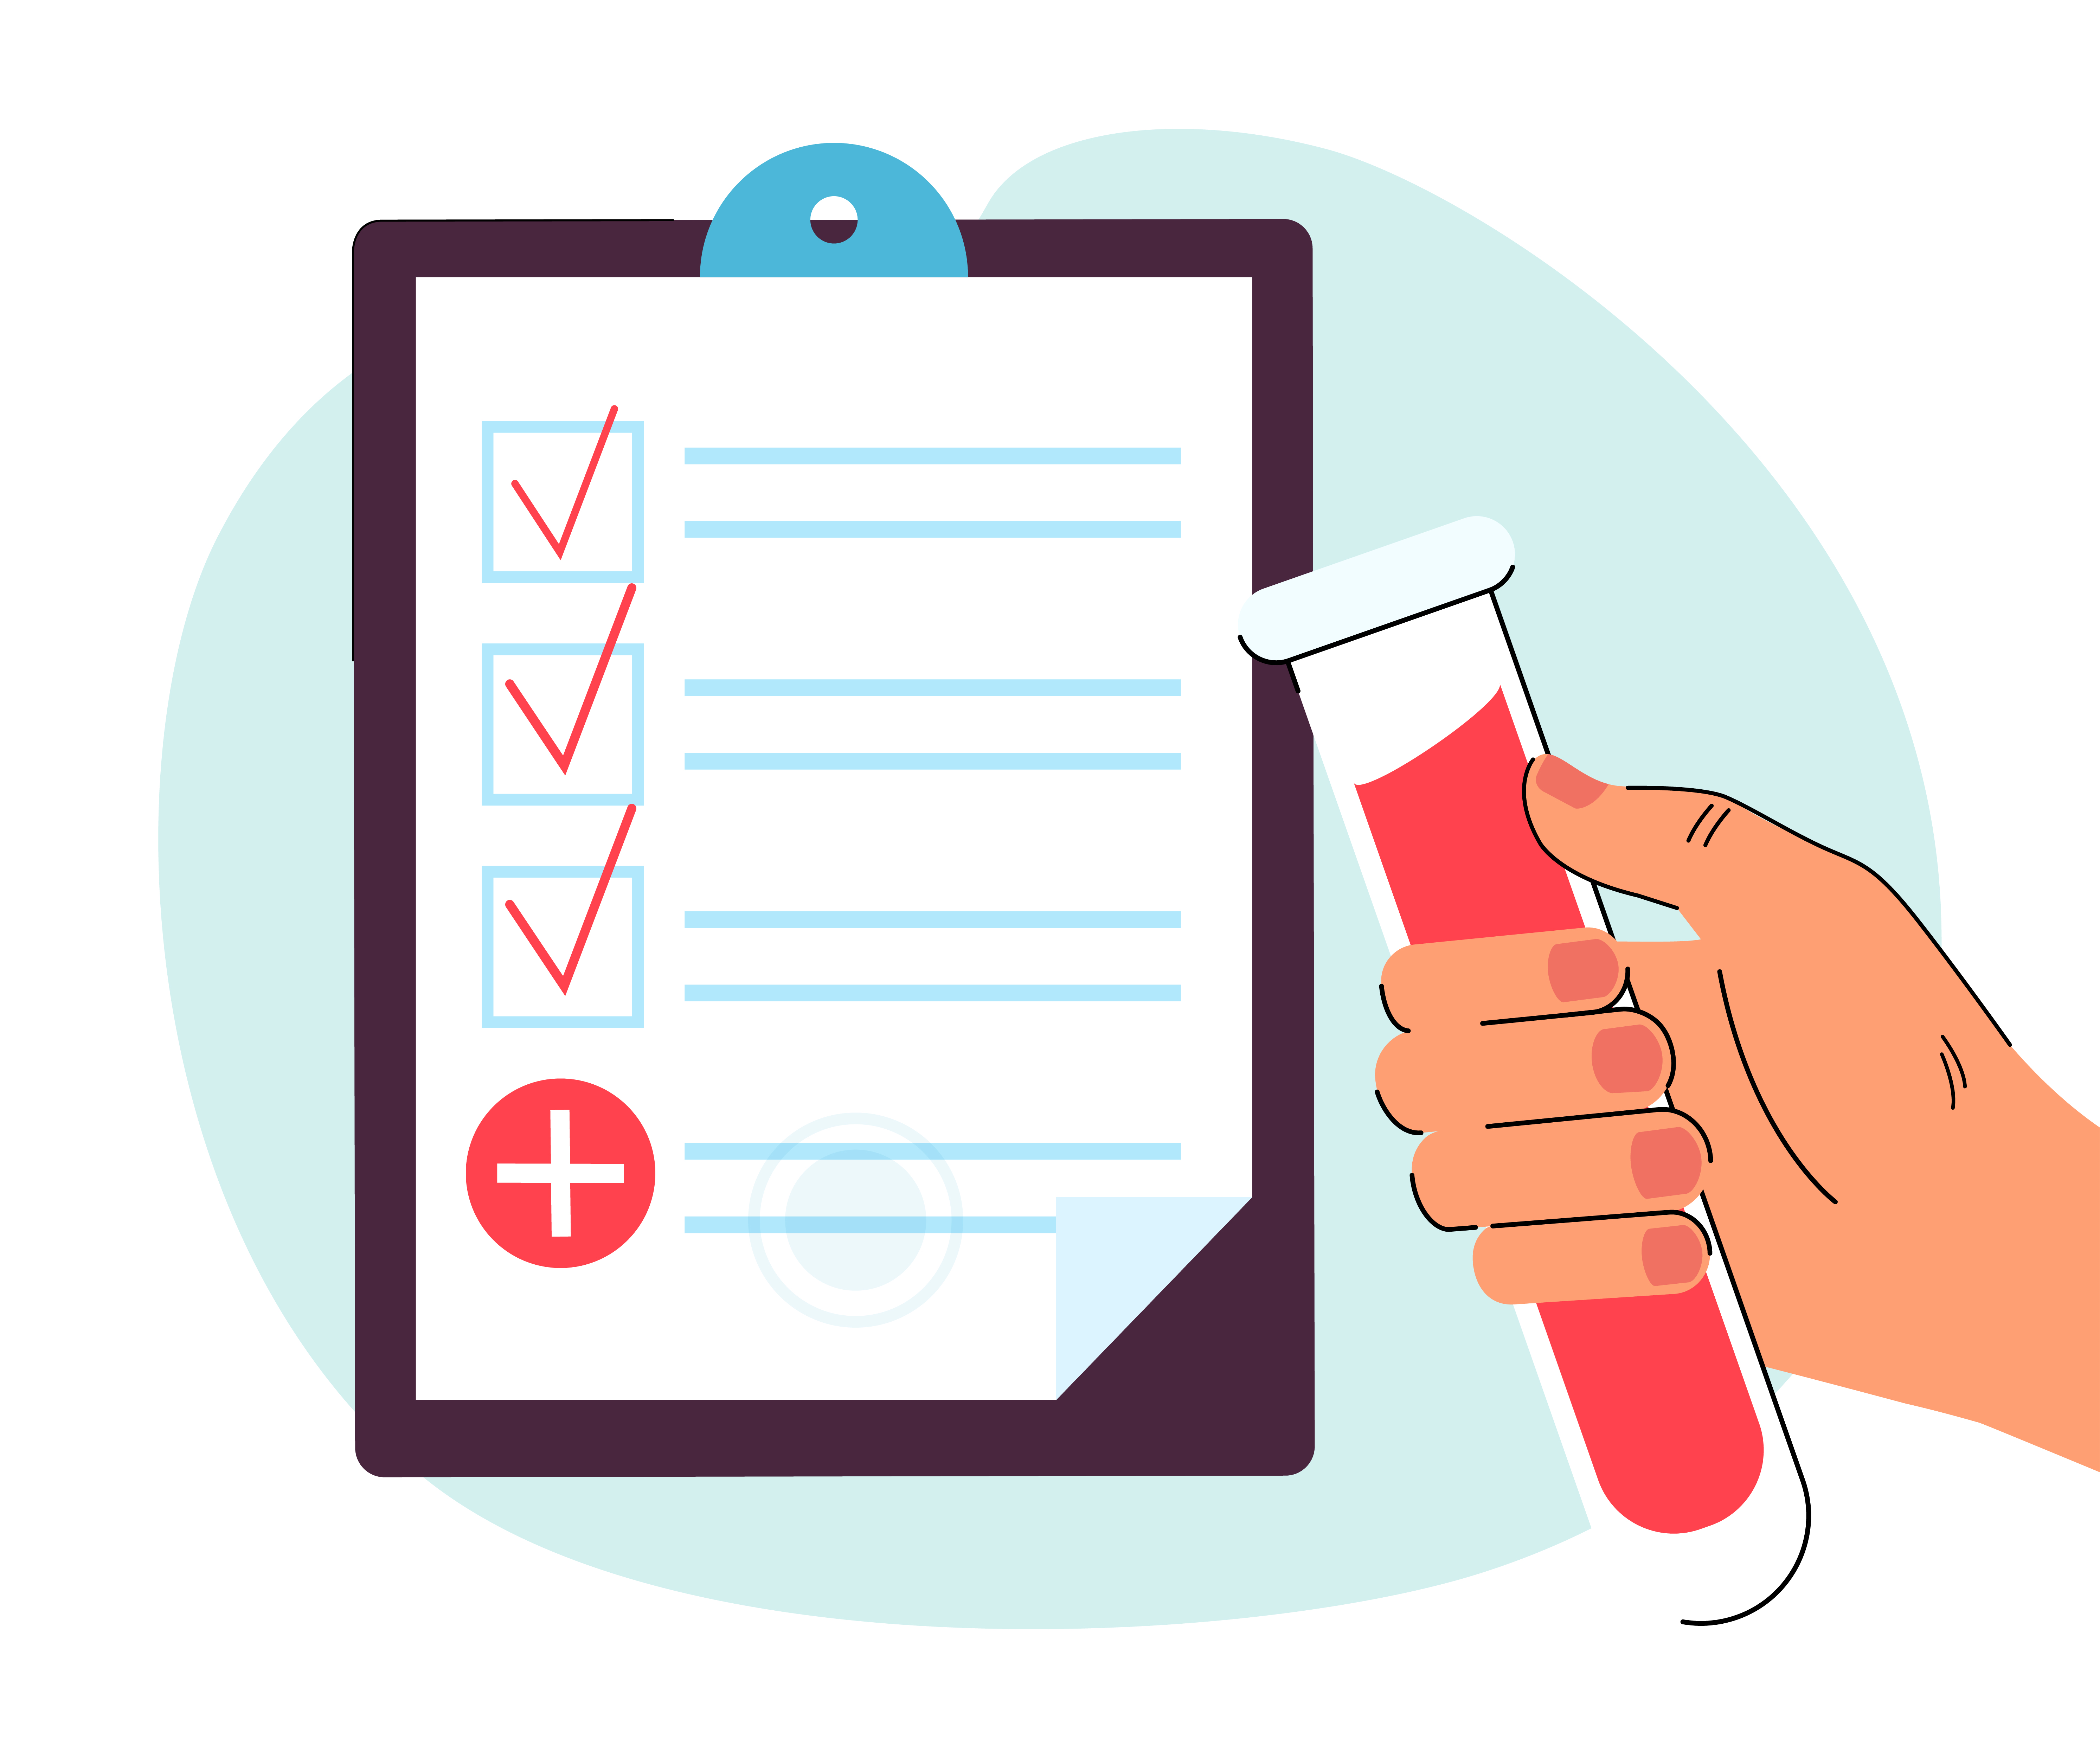
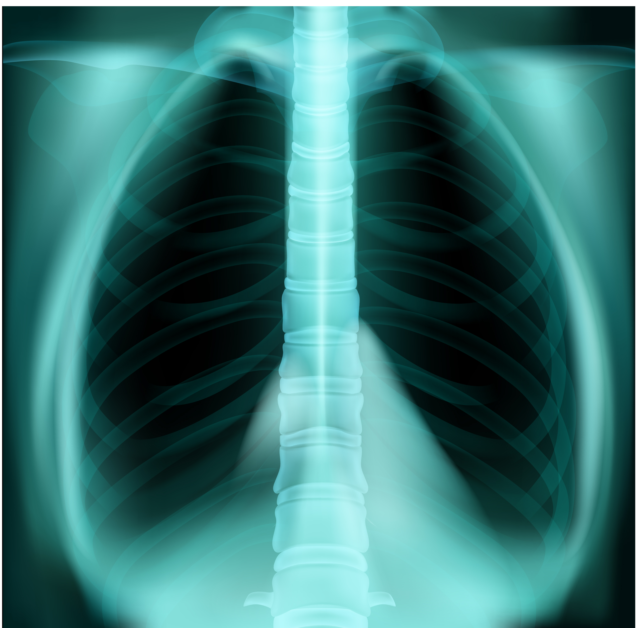

System Overview
08
core functionalities:
Disease detection via lab test data.
System Overview:
Radiology image analysis.
Report Generation.

Slide 27
Dataset:
Diabetes Dataset:
Collected an initial dataset for diabetes from Kaggle, containing approximately 100,000 records.
This dataset served as the foundation for developing and testing our first predictive model.
COVID‑19 Disease:
13,989 training and 100 test radiographs sourced from Kaggle, capturing diverse COVID‑19 presentations to support early and accurate diagnosis. Link“https://www.kaggle.com/datasets/tawsifurrahman/covid19-radiography-database”
Pneumonia Dataset:
5,216 training and 650 test chest X‑rays from Kaggle, expertly labeled to power deep‑learning models for rapid pneumonia detection. Link”https://www.kaggle.com/datasets/paultimothymooney/chest-xray-pneumonia”
Tuberculosis Disease:
3,500 training and 700 test X‑ray images from Kaggle, annotated by experts for precise TB screening and model validation. Link” https://www.kaggle.com/datasets/tawsifurrahman/tuberculosis-tb-chest-xray-dataset”

Slide 28
Dataset:
Anemia Disease:
In collaboration with local laboratories, we collected data anonymized CBC cases—bridging the gap where public data fell short.
Liver Disease:
Leveraged Kaggle’s rich liver‑biomarker profiles, delivering high‑quality clinical inputs for accurate disease modeling. Link “https://www.kaggle.com/datasets/rabieelkharoua/predict-liver-disease-1700-records-dataset/data”
Parkinson’s Disease:
Utilized a diverse Kaggle set capturing both motor and non‑motor indicators, strengthening our model’s early‑detection capabilities. Link” https://www.kaggle.com/datasets/rabieelkharoua/parkinsons-disease-dataset-analysis/data ”
Viral Infection Disease:
Integrated detailed blood test parameters from Kaggle infection cases, providing robust features for precise viral‑illness prediction. Link “https://www.kaggle.com/datasets/brsahan/viral-infection-study-dataset”

Slide 29
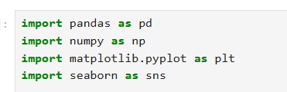
Methodology (ML):
Diapetes
Frist Import libraries:
Scikitlearn
Pandas
NumPy
Matplotlib
Seaborn
import dataset and read Use Pandas, then make show and exploration for data with analyzing it .
Data Preprocessing:
The dataset was cleaned by removing duplicates and handling missing values .
Also converting the data from the Category data format to Numerical data so that the model can be trained .
In this step, more than one ratio was used, but we discovered that the best ratio for dividing the data is 80% for training 20% for testing .

Slide 30
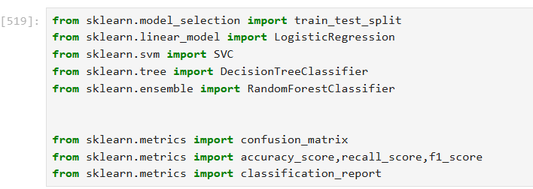
Methodology (ML):
Model used:
We tested several machine learning algorithms, including:
Logistic Regression
Support Vector Machine (SVC)
Decision Tree Classifier
Random Forest Classifier
Accuracy Results:
The initial accuracy of similar datasets in literature was around 94% .
Through our preprocessing, we improved the accuracy to 96% using Random Forest.
Best Model :
Random Forest Classifier achieved the highest accuracy, recall, and F1-score, making it the best choice for our application.

Slide 31
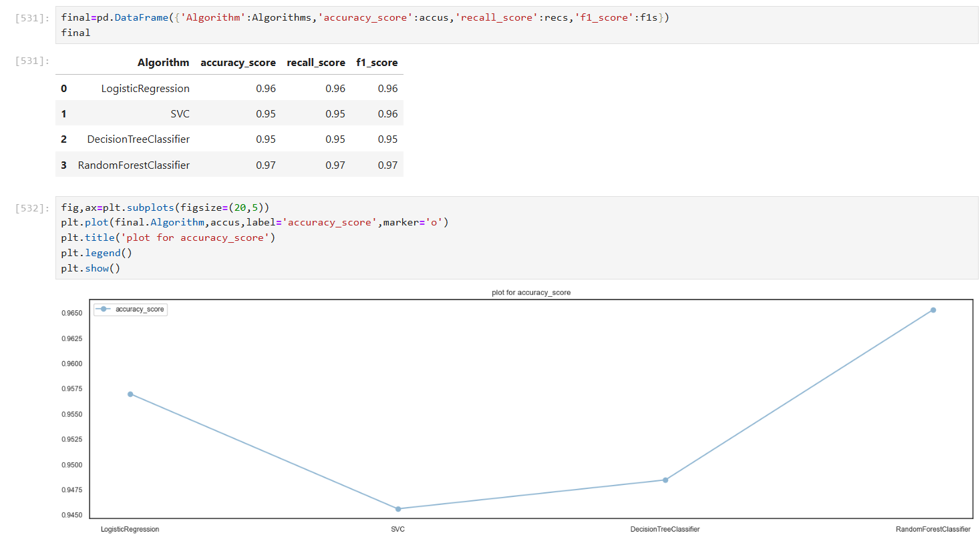
Methodology (ML):

Slide 32
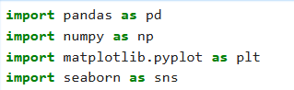
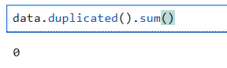
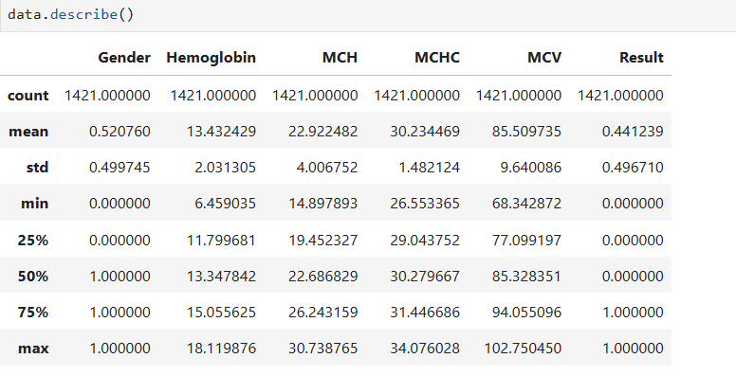
Methodology (ML):(count…..)
Anemia
Frist Data Loading & Structure:
Imported libraries: pandas, numpy, matplotlib, seaborn
Loaded dataset (6 columns : Gender, Hemoglobin, MCH, MCHC, MCV, Result)
Checked for duplicates and missing values → 0 duplicates , no nulls
Second Descriptive Statistics:
Summary statistics (.describe()):
Mean Hemoglobin ≈ 13.43 g/dL
Result (anemia) balanced: ~44% positive

Slide 33
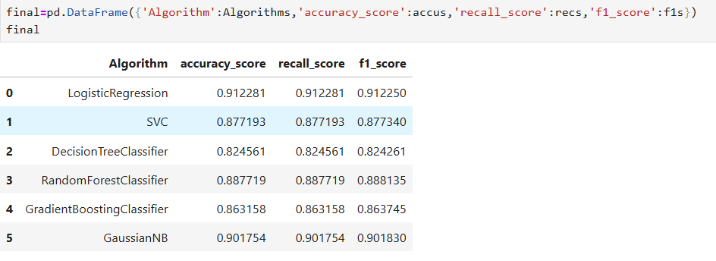
Methodology (ML):(count…..)
Train/Test Split:
80 train / 20 test split → ( random_state=42)
Algorithms Compared:
Best Model :
Logistic Regression achieved the highest accuracy, recall, and F1-score, making it the best choice for our application.

Slide 34
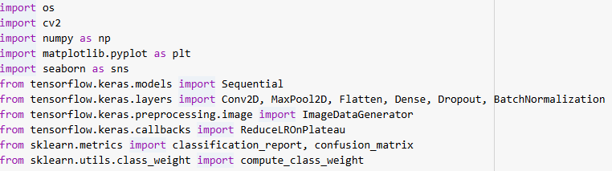
Methodology (ML):(count…..)
Pneumonia
Frist Data Loading & Preprocessing:
Imported libraries: tensorflow, keras , numpy, matplotlib, seaborn
Loaded chest X‑ray images for PNEUMONIA vs NORMAL
Checked class balance → applied class weights to counter imbalance
Image augmentation: rotation, zoom, shifts, horizontal flip
CNN Architecture:
5 Conv ‑blocks :
Conv2D → BatchNorm → (Dropout) → MaxPool
Filters: 32 → 64 → 64 → 128 → 256
Dense head: Flatten → Dense(128, ReLU) → Dropout(0.2) → Dense(1, sigmoid)
Optimizer: RMSprop, Loss: binary_crossentropy

Slide 35
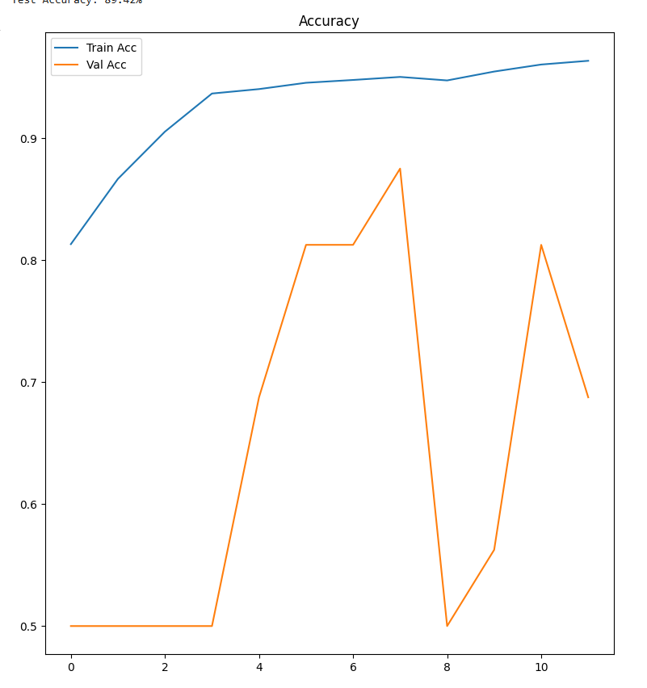
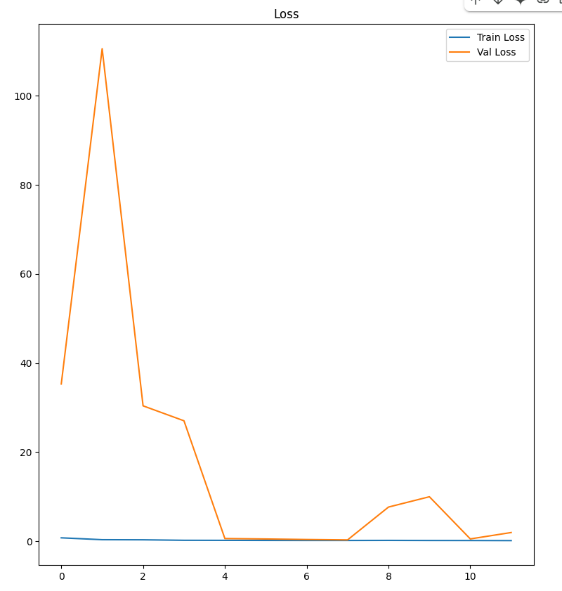
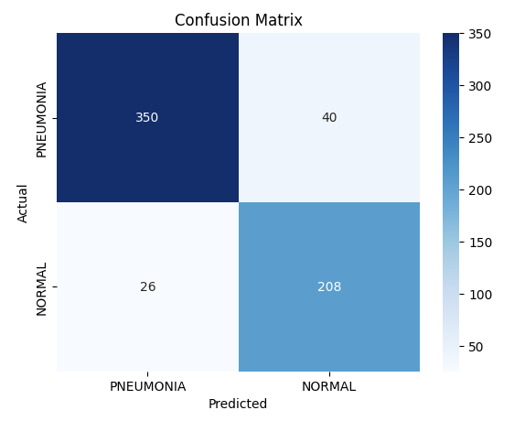
Methodology (ML):(count…..)
Training Performance (12 epochs):
Final Train Accuracy ≈ 96.7%
Final Validation Accuracy peaked at ~87.5%
Test Set Evaluation:
Test Accuracy: 89.42%
Confusion Matrix:
Pneumonia → Precision 93%, Recall 90%
Normal → Precision 84%, Recall 89%

Slide 36
Challenges Faced and solution
9
Collecting data for training our models.
Solutions : We searched online for datasets that matched our concept , purpose, and also acquired a suitable set from a local laboratory.
Designing a simple application interface for ease of use.
Solutions : We researched minimalist UI designs to gain inspiration and adopt straightforward, user‑friendly layouts.
Deploying trained models to a server.
Solutions : We evaluated several hosting services, chose render.com for its features, and successfully deployed our models there.

Slide 37
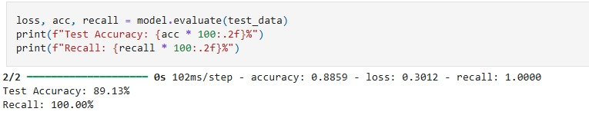
Methodology (ML):(count…..)
COVID-19
Objective: Automatically classify chest X-rays into COVID-19 and Normal.
Why it matters: Early detection of COVID-19 is critical.
Tools Used: Python, TensorFlow, Keras, NumPy, Matplotlib
Dataset: COVID-19 Radiography Database (Kaggle)
Classes Used: Only 'COVID' and 'Normal'
Model Architecture & Results
Steps:
- Data Preprocessing & Augmentation
- CNN: Conv2D → MaxPooling2D → Dense → Sigmoid
- Training and Validation
Results:
- Accuracy: 89.13%
- Recall : 100%
Inference Example:
result = predict_image("xray.jpg")
print(result) # Output: COVID / NORMAL

Slide 38
Conclusion
10
Impact:
Simplifies healthcare access for remote areas.
Enables early and accurate disease detection, empowering patients to take proactive health measures
Innovation:
Combines ML and user-centric design for effective health solutions.
Attached Report: Inspirational PDF showing app-driven healthcare improvements.

Slide 39
Future Work
Expand to support more diseases.
Implementing a medical record system to store and track user health history.
Support multi language to serve different cultures.
AI Chat Assistant for health queries.
Computer Vision

Slide 40
Reference
Miotto, R., Wang, F., Wang, S., Jiang, X., & Dudley, J. T. (2018).
Deep learning for healthcare: review, opportunities and challenges.
Briefings in Bioinformatics, 19(6), 1236–1246.
https://doi.org/10.1093/bib/bbx044
Rajpurkar, P., Irvin, J., Zhu, K., Yang, B., Mehta, H., Duan, T., … & Ng, A. Y. (2017).
CheXNet: Radiologist-level pneumonia detection on chest x-rays with deep learning.
arXiv preprint arXiv:1711.05225.
Retrieved from https://arxiv.org/abs/1711.05225
Kavakiotis, I., Tsave, O., Salifoglou, A., Maglaveras, N., Vlahavas, I., & Chouvarda, I. (2017).
Machine learning and data mining methods in diabetes research.
Computational and Structural Biotechnology Journal, 15, 104–116.
https://doi.org/10.1016/j.csbj.2016.12.005
Topol, E. J. (2019).
High-performance medicine: the convergence of human and artificial intelligence.
Nature Medicine, 25 (1), 44–56.
https://doi.org/10.1038/s41591-018-0300-7
Hsu, C. W., Chou, D. L., & Tseng, V. S. (2020).
A novel framework of building intelligent medical diagnosis systems with multiple chronic diseases.
IEEE Access, 8 , 123456–123467.
https://doi.org/10.1109/ACCESS.2020.2998987

Slide 41
GitHup Repositories:
Project: “https://github.com/fady103/Graduation_Project_final”
Deployment: “https://github.com/fady103/medical-diagnosis-api”

Slide 42
Thanks FOR YOUR ATTENTION!

